Slide 1
JavaScript
Browser popups,
switch construction and loops

Slide 2
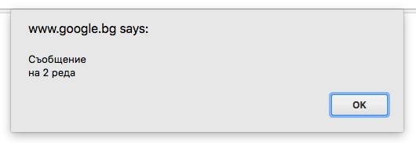
Browser popups
Showing a message
alert(text);
alert('Message\non 2 rows');

Slide 3
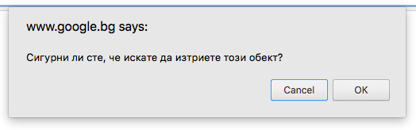
Browser popups
Ask a question.
confirm(question)
if (confirm) { Confirm the action } else { Cancel the action } if (confirm('Are you sure you want to delete this object?')) { Confirm the action }

Slide 4
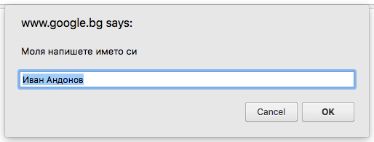
Browser popups
Request a data from the user
prompt(message, default value);
prompt('Please write your name', 'Ivan Andonov');
const name = String(prompt('Please write your name', 'Ivan Andonov')).trim(); if (name !== null && name !== 'null' && name.length) { console.log('The name is: ' + name); } else { console.log('The user doesn\'t want to give his name!'); }

Slide 5
Switch construction
switch (value) { case value1: action1; break; case value2: action2; break; default: action3; }

Slide 6
Switch construction
switch (value) { case value1: action1; break; case value2: action2; break; default: action3; }
if (value === value1) { action1; } else if (value === value2) { action2; } else { action3; }

Slide 7
Switch construction
switch (value) { case value1: action1; case value2: action2; break; case value3: action3; break; default: action4; }

Slide 8
Switch construction
switch (value) { case value1: action1; case value2: action2; break; case value3: action3; break; default: action4; }
if (value === value1) { action1; action2; } else if (value === value2) { action2; } else if (value === value3) { action3; } else { action4; }

Slide 9
Loops
Loop types
while - until the condition is true keep execution
do while - similar to while but first execute the code and then check for the condition
for - until the condition is true keep execution with option to define variables important for the loop and making change that is related to the condition
for in - loops over enumerable property names of an object.
for of - (new in ES6) does use an object-specific iterator and loops over the values generated by that.

Slide 10
Loops
while loop - until the condition is true keep execution
while (condition) { code for execution }

Slide 11
Loops
while loop - until the condition is true keep execution
var i = 0; var text = '';
while (i < 5) { i++; text += i; } console.log(text); // '12345'

Slide 12
Loops
continue - break the current iteration of the loop
var i = 0; var text = '';
while (i < 5) { i++; text += i; } console.log(text); // '12345'
var i = 0; var text = '';
while (i < 5) { i++; if (i === 3) { continue; } text += i; } console.log(text); // '1245'

Slide 13
Loops
break - break the execution of the loop
var i = 0; var text = '';
while (i < 5) { i++; text += i; } console.log(text); // '12345'
var i = 0; var text = '';
while (true) { i++; text += i; if (i >= 5) { break; } } console.log(text); // '12345'

Slide 14
Loops
do while loop - first execute the code and then check for the condition
do { code for execution } while (condition)

Slide 15
Loops
do while loop - first execute the code and then check for the condition
var i = 0; var text = '';
do { i++; text += i; } while (i < 5) console.log(text); // '12345'

Slide 16
Loops
continue - break the current iteration of the loop
var i = 0; var text = '';
do { i++; text += i; } while (i < 5) console.log(text); // '12345'
var i = 0; var text = '';
do { i++; if (i === 3) { continue; } text += i; } while (i < 5) console.log(text); // '1245'

Slide 17
Loops
break - break the execution of the loop
var i = 0; var text = '';
do { i++; text += i; } while (i < 5) console.log(text); // '12345'
var i = 0; var text = '';
do { i++; text += i; if (i >= 5) { break; } } while (true) console.log(text); // '12345'

Slide 18
Loops
For loop - until the condition is true keep execution with option to define variables important for the loop and making change that is related to the condition
for (definition; condition; action) { code for execution }

Slide 19
Loops
For loop - until the condition is true keep execution with option to define variables important for the loop and making change that is related to the condition
let text = '';
for (let i = 0; i < 5; i++) { text += i; } console.log(text); // '01234'

Slide 20
Loops
For loop - until the condition is true keep execution with option to define variables important for the loop and making change that is related to the condition
let text = '';
for (let i = 0; i < 5; i++) { text += i; } console.log(text); // '01234'
let text = ''; let i = 0;
for ( ; i < 5; i++) { text += i; } console.log(text); // '01234'

Slide 21
Loops
For loop - until the condition is true keep execution with option to define variables important for the loop and making change that is related to the condition
let text = ";
for (let i = 0; i < 5; i++) { text += i; } console.log(text); // '01234'
let text = ''; let i = 0;
for ( ; i < 5; i++) { text += i; } console.log(text); // '01234'
let text = ''; let i = 0;
for ( ; i < 5; ) { text += i; i++; } console.log(text); // '01234'

Slide 22
Loops
For loop - until the condition is true keep execution with option to define variables important for the loop and making change that is related to the condition
let text = '';
for (let i = 0; i < 5; i++) { text += i; } console.log(text); // '01234'
let text = ''; let i = 0;
for ( ; i < 5; i++) { text += i; } console.log(text); // '01234'
let text = ''; let i = 0;
for ( ; i < 5; ) { text += i; i++; } console.log(text); // '01234'
let text = ''; let i = 0;
for ( ; ; ) { if ( i >= 5 ) { break; } text += i; i++; } console.log(text); // '01234'

Slide 23
Loops
For in loop - loops over enumerable property names of an object.
for (let propertyName in object) { code for execution }

Slide 24
Loops
For in loop - loops over enumerable property names of an object.
const myObject = { name: 'Ivan', town: 'Burgas' }; let names = ''; let values = ''; for (let key in myObject) { names += key; values += myObject[key]; } console.log(names); // 'nametown' console.log(values); // 'IvanBurgas'

Slide 25
Loops
For in loop - loops over enumerable property names of an object.
const myObject = { name: 'Ivan', town: 'Burgas' }; let names = ''; let values = ''; for (let key in myObject) { names += key; values += myObject[key]; } console.log(names); // 'nametown' console.log(values); // 'IvanBurgas'
const myArray = ['a', 'b', 'c']; let names = ''; let values = ''; for (let key in myArray) { names += key; values += myArray[key]; } console.log(names); // '012' console.log(values); // 'abc'

Slide 26
Loops
Nested loops
let row = 0; while (row < 3) { for (let col = 0; col < 3; col++) { console.log('current cell: ' + row + ':' + col); } row++; }

Slide 27
Loops
Breaking the execution of the a higher level loop
let row = 0; label: while (row < 3) { for (let col = 0; col < 3; col++) { if (row && col) { console.log('last cell: ' + row + ':' + col); break label; } console.log('current cell: ' + row + ':' + col); } row++; }

Slide 28
Hard Work
Dedication

